Slide 1
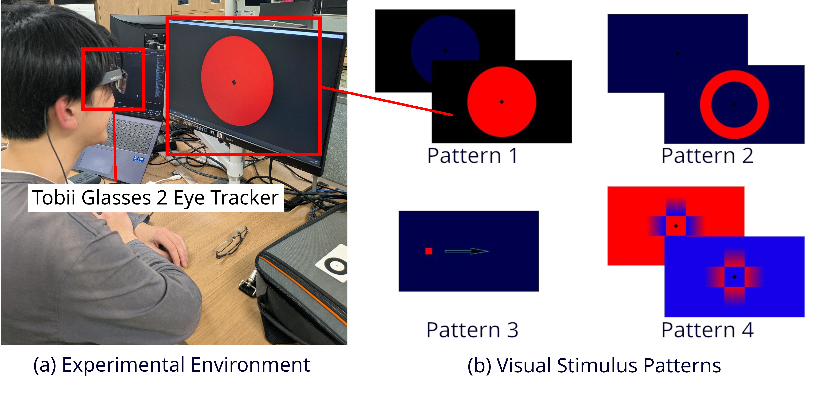
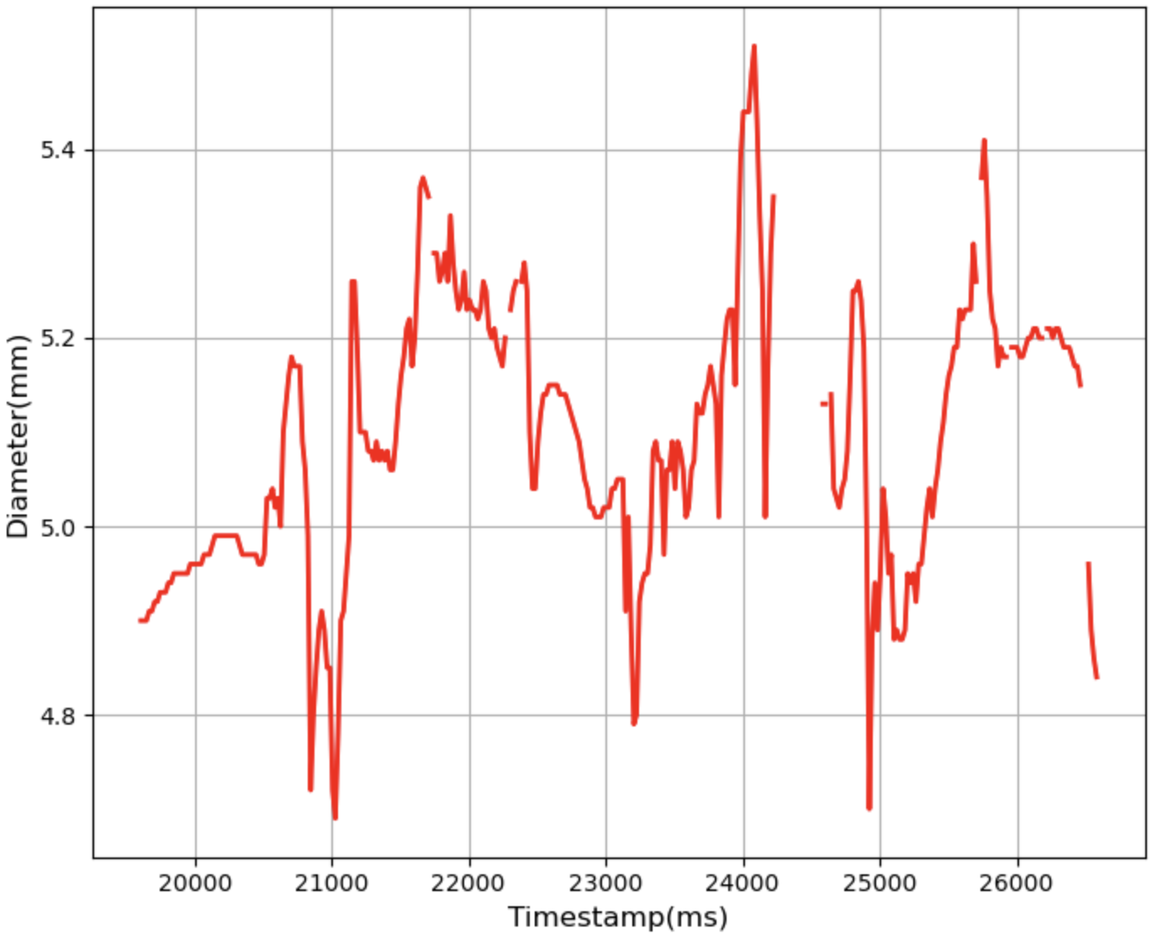
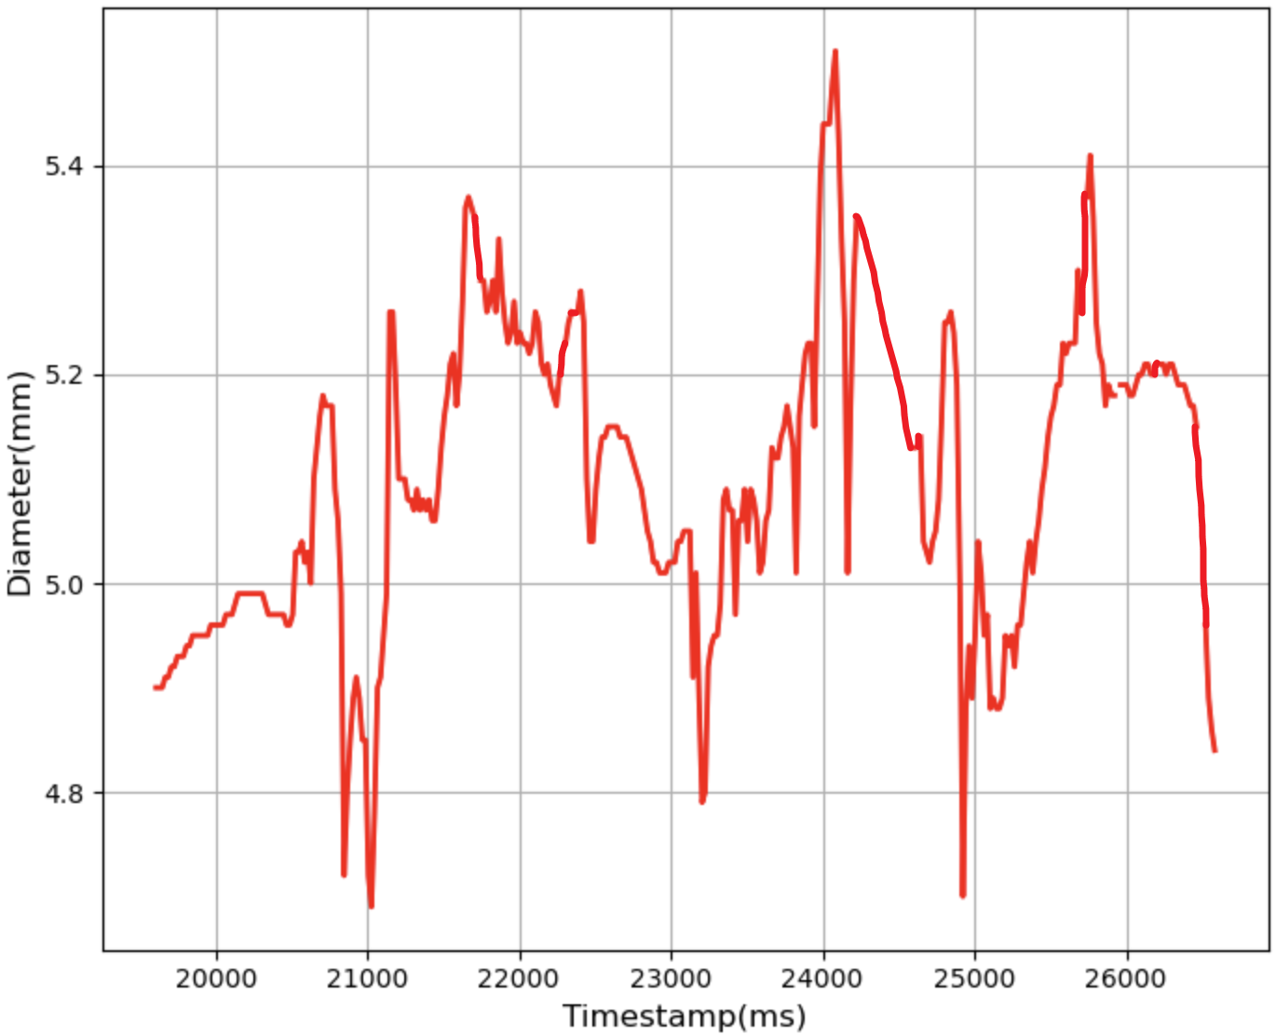
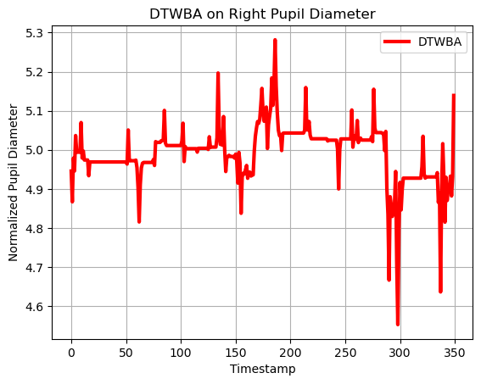
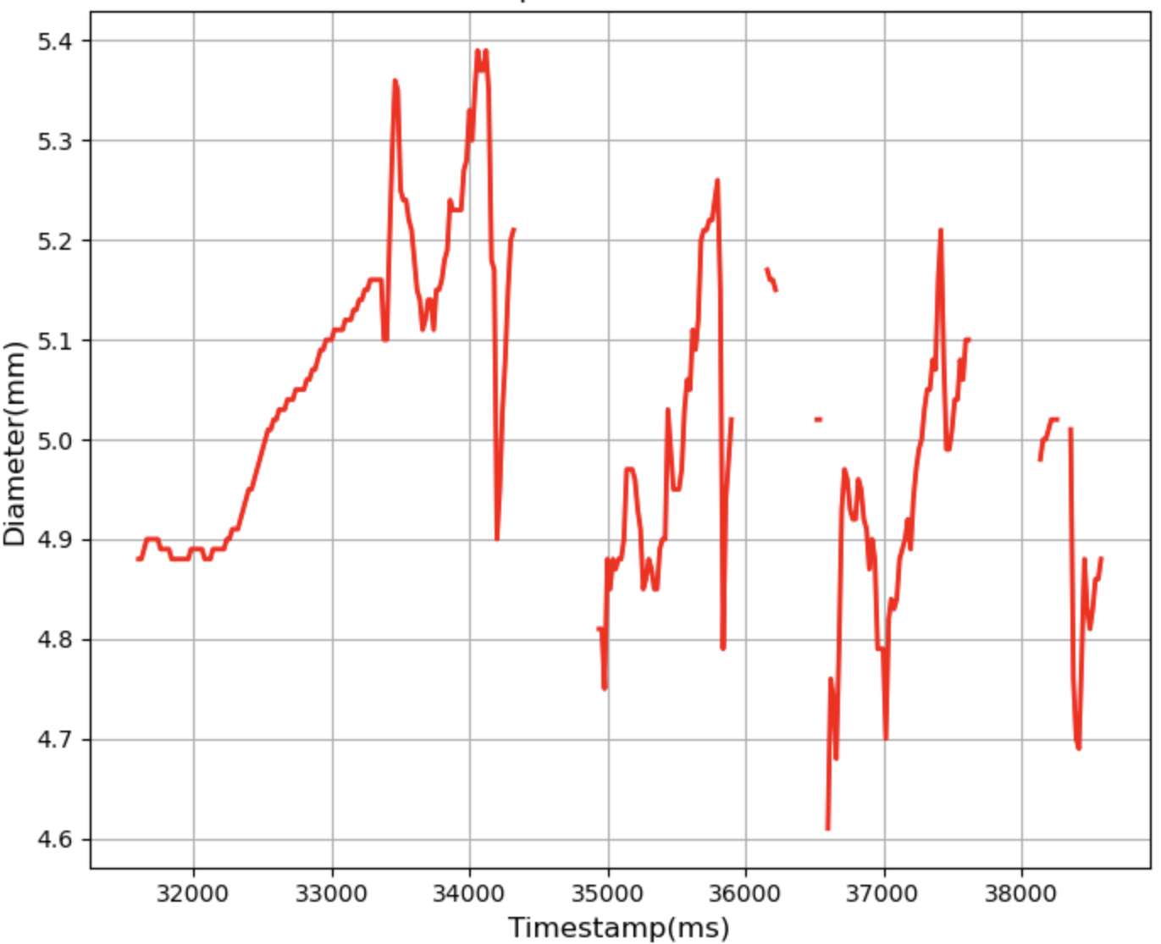
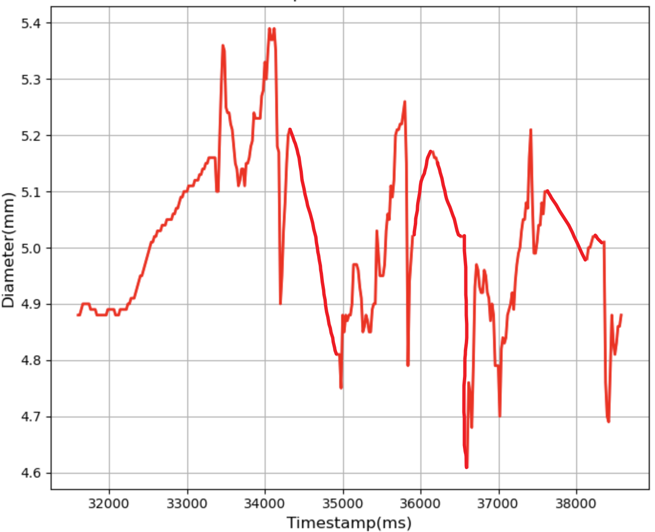
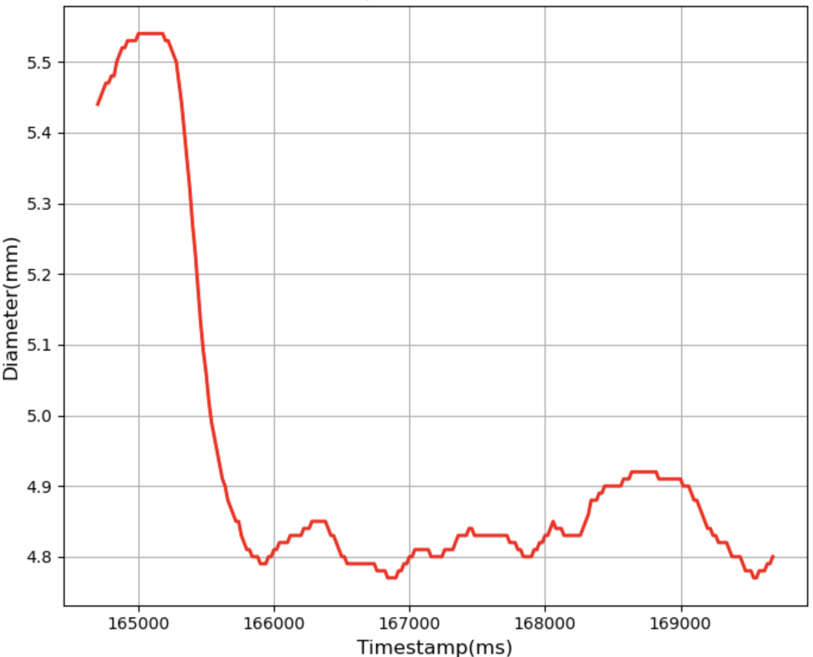
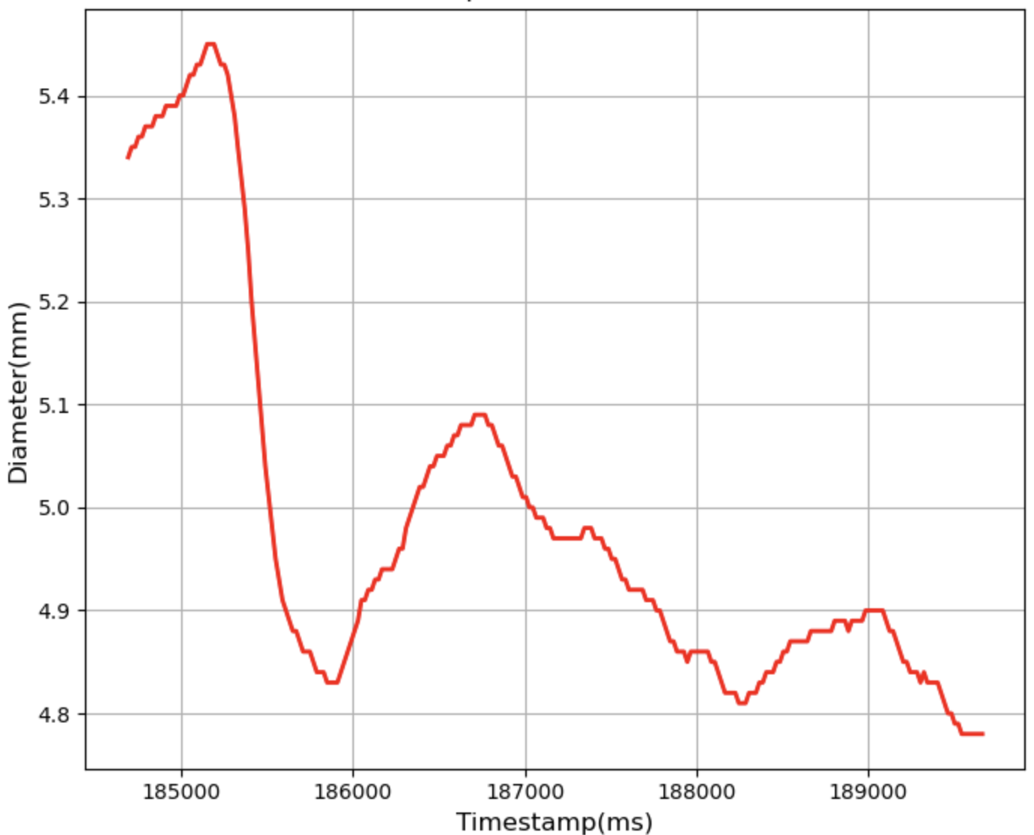
(a) Data Collection
(b)Linear Interpolation & DBA Generation
Origin Interpolated DBA
… …
(d) Threshold Determination
(c) DTW Computation
The DTW Threshold for DBA’s Owner
DBA Comparing with its Owner
DBA Comparing with Another Participant
DTW distances computed with DBA’s Owner
0.89
1.03
1.21
1.26
… …
2.14
2.20
2.45
2.56
… …
1
2
3
DTW distances computed with Another Participant
… …
… …

